Slide 1







MSME IDEA HACKATHON 3.0
Department of Information Technology
Indian Traders: Journey Across the Subcontinent
Presented By:
Anisa.F (73772221109)
Mehasri.M.A (73772221160)
I year IT-A
Sector: Service Sector (Education),
Theme: AVGC (Animation, Visual, Gaming, Comics)
Project Mentor:
DrJ.NithyaB.E.,M.E.,PhD,
Department of Information Technology
nithyaj@ksrct.ac.in

Slide 2


Problem Statement:
The lack of an engaging and educational board game prevents players from learning about the diverse goods and trading opportunities in Indian cities while experiencing the cultural richness of the country.
Newness/uniqueness of the innovation:
Immersive cultural experience: Integrating the diverse culture, traditions, and climates of Indian cities.
Realistic trading mechanics: Simulating real-world market dynamics and economic principles.
Interactive learning: Engaging and enjoyable gameplay that promotes critical thinking and knowledge retention.
Customizable gameplay: Adaptable difficulty levels and rule variations for different preferences and skill levels.
Cross-cultural exchange: Promoting communication, negotiation skills, and appreciation for different perspectives.
Replayability and variety: 100 unique city cards and randomized gameplay for endless entertainment value.

Slide 3
Concept:
"Treasures of India: A Trading Expedition" is a board game that combines entertainment and education, allowing players to embark on a journey across India to explore famous cities, learn about their unique goods, and engage in strategic trading activities.
Objective:
The objective of the game is for players to accumulate the most wealth by making shrewd trading decisions, leveraging market conditions, and capitalizing on the diversity of goods found in Indian cities.
Through gameplay, players will enhance their knowledge of Indian culture, geography, and trading practices while honing their strategic thinking and decision-making skills.

Slide 4
Potential areas of the industry/market for "Treasures of India: A Trading Expedition“ :
Educational Institutions: Marketing the game to schools, colleges, and educational institutions as a tool to teach students about Indian culture, geography, economics, and trading principles.
Tourism and Travel Industry: Collaborating with travel agencies, tourist attractions, or hotels to promote the game as a cultural and educational experience for tourists visiting India.
Gift and Souvenir Shops: Partnering with gift and souvenir shops to feature the game as a unique and educational souvenir related to Indian culture and trading heritage.
Online Retail Platforms: Leveraging e-commerce platforms to reach a wider audience, offering the game as an educational and entertaining product with nationwide or global shipping capabilities.

Slide 5
The Market Potential for "Treasures of India: A Trading Expedition:
Growing Board Game Industry: The board game industry is experiencing steady growth, creating opportunities for unique and engaging games like "Treasures of India.“
Educational and Cultural Focus: The game's emphasis on Indian culture, geography, and trading practices aligns with the rising interest in educational and culturally immersive experiences.
Indian Tourism Boom: The surge in Indian tourism provides an opportunity for "Treasures of India" to offer tourists a fun and educational game that explores famous cities and goods, serving as a memento of their travel experience.
Cross-Cultural Appeal: The game appeals to players globally who are interested in learning about different cultures, fostering cross-cultural exchange, and enjoying strategic gameplay.
Collaborative Partnerships: Collaborating with educational institutions, tourism agencies, and cultural organizations can expand the game's market potential, incorporating it into curricula or promoting it at cultural events.

Slide 6
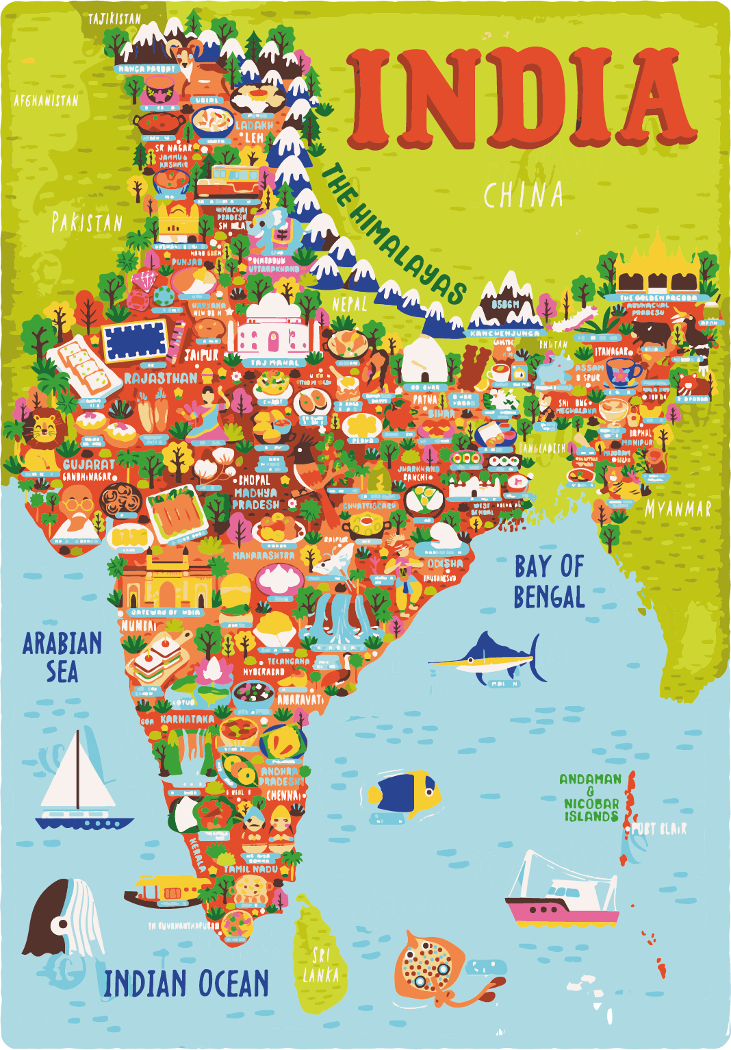
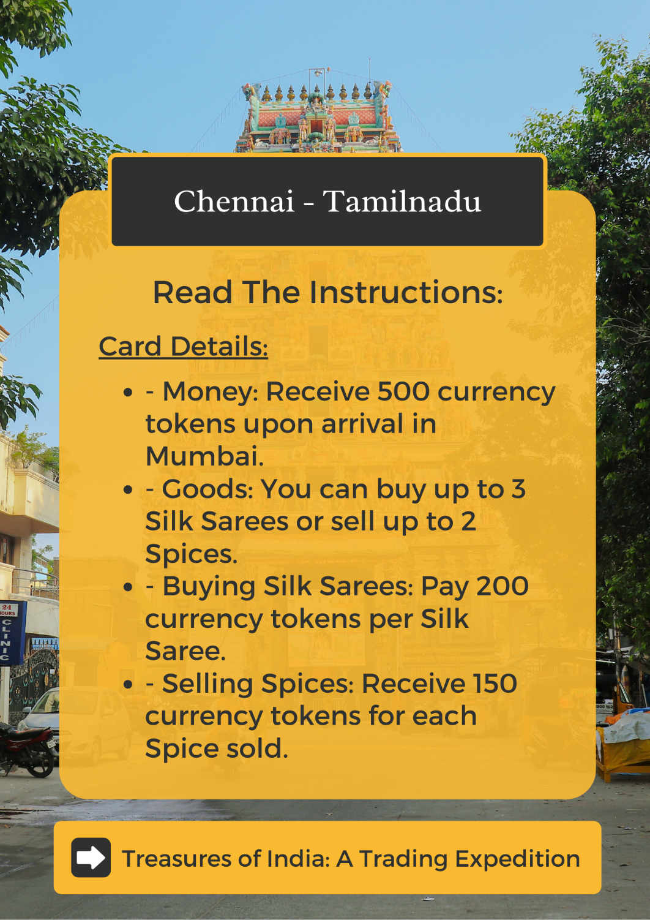
Sample Images:

Slide 7
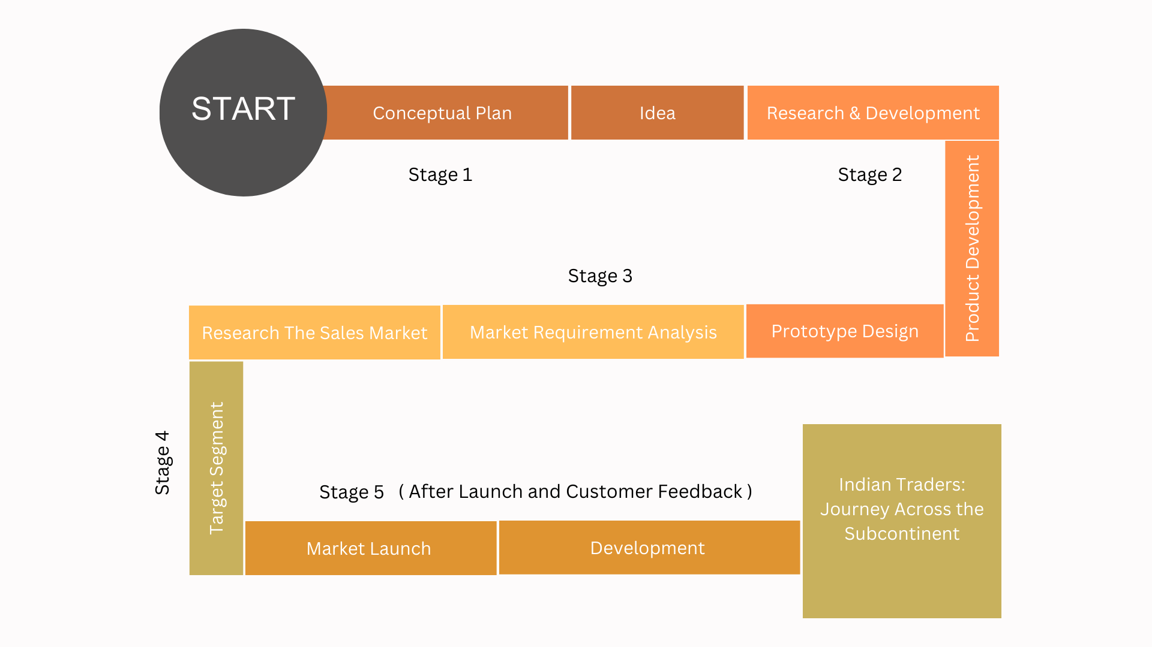
Marketing Strategy:
Plan & project time to hit market:
Concept Development (1-2 months)
Design and Artwork (2-3 months)
Prototyping and Playtesting (2-3 months)
Production Planning (1-2 months)
Production and Manufacturing (2-4 months)
Graphic Design and Packaging (1-2 months)
Marketing and Promotion (3-4 months)
Distribution and Retail (1-2 months)
Launch and Release (1 month)

Slide 8
Budget Plan:
Expense Category | Considerations | Amount
Game Design and Development | Hiring designers and developers, software and equipment | 180000
Artwork and Illustrations | Professional artists, licensing fees, revisions | 80,000
Manufacturing and Production | Printing, materials, quality control | 100000
Marketing and Promotion | Advertising, social media campaigns, PR | 150000
Packaging and Printing | Box design, rule book, component printing | 70,000
Miscellaneous | Prototyping, playtesting, legal fees | 58,000
Contingency (10% of Total) | Unexpected expenses or adjustments | 78,000
Total | - | 716000

Slide 9


Target Audience:
Online Gaming
Platforms
Demographics: Age category of above 10, both genders
Psychographics: Curious learners, interested in geography and culture, seek educational experiences through gaming, Families seeking interactive and educational activities, enjoy gaming as a bonding experience, Value strategic thinking, enjoy complex decision-making, seek engaging gameplay experiences
Behaviour: Likely to buy online, engaged in educational or cultural communities or platforms
Applications
Family and Social Gatherings
Educational
Institutions
Gift and
Souvenir Shops
Cultural Events and Festivals
Retail and
E-commerce

Slide 10
Competitive Analysis:
Competitor | Innovation and Uniqueness | Strengths | Weaknesses
Indian Traders: Journey Across the Subcontinent | Offers a unique trading experience in Indian cities. | Cultural authenticity and immersion. | Lack of brand recognition.
Theboardgameco | Known for innovative game mechanics and unique themes. | Established brand in the board game market. | Limited focus on Indian culture and themes.
Ratna's | Emphasizes educational and family-friendly gameplay. | Strong reputation for educational games. | May not have a specific focus on trading mechanics.
Sillyme | Offers humorous and light-hearted gameplay experiences. | Appeals to a wide range of players. | Limited thematic depth for trading mechanics.

Slide 11
Future Scope:
Advantages:
Expansion Packs: Introduce additional cities, goods, and challenges.
International Edition: Adapt the game to showcase goods and trading history of other countries.
Digital Version: Develop a mobile or online version for wider accessibility.
Collaborations: Partner with tourism boards, cultural organizations, or educational institutions.
Educational Integration: Incorporate the game into curricula and educational programs.
Localization: Translate the game into different languages for international markets.
Community Engagement: Build an active community for feedback and support.
Educational Value
Engaging Gameplay
Cultural Immersion
Replayability and Variety
Social Interaction
Authentic Trading Experience
Customizability

Slide 12
Conclusion:
"Treasures of India: A Trading Expedition" is an innovative and educational board game that offers a unique blend of entertainment, cultural immersion, and strategic trading gameplay.
With its focus on Indian culture, diverse goods, and realistic trading mechanics, the game provides an engaging and immersive experience for players.
It stands out in the market by offering educational value, replayability, skill development, and the opportunity for cross-cultural exchange.
With its potential to target board game enthusiasts, educational institutions, tourists, online platforms, and cultural events, the game has significant market potential.
"Treasures of India" is poised to captivate players, foster learning, and leave a lasting impression as a standout game in the board game industry.

